Slide 1

Style Transfer for Headshot Portraits
Github Repo: https://github.com/Digital-Image-Processing-IIITH/project-mandelbrot
Team : Mandelbrot
Team Members : Amarthya Sasi Kiran
Sai Krishna Charan Dara
Sai Deva Harsha Annam
Venkata Susheel Voora
Mentor : Soumyasis Gunn

Slide 2
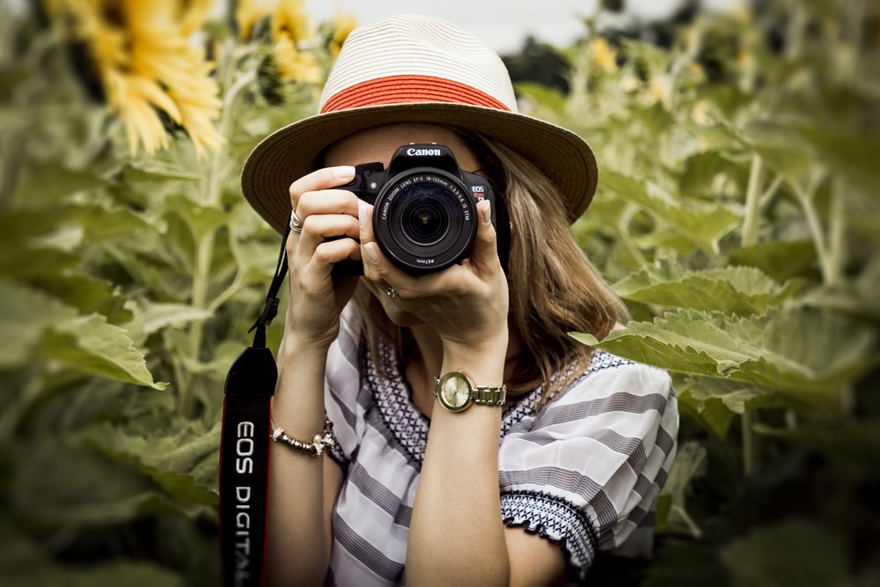
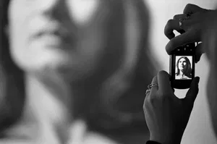
Motivation
Headshot portraits are commonly taken in professional settings, and a lot of time and effort is spent in styling these photographs, through various editing methods.
Each feature - eyes, skin, eyebrows, mouth, hair, all require specific treatment. This project uses a combination of various techniques to style an amateur input image using other, professionally taken styled portraits.

Slide 3
Preview
Users provide an input portrait photo and an example stylized portrait, and our algorithm processes the input to give it same visual look as the example.
The output headshot that we seek to achieve is the input subject, but as if taken under the same lighting and retouched in the same way as the example.
We also support the case in which an artist has produced a collection of portraits in a consistent style. In this case, our algorithm automatically picks a suitable example among the collection, e.g., matching beardless examples to beardless inputs.

Slide 4
Approach
Foreground-Background mask generation
Dense Correspondence
Multiscale Transfer of Local Contrast
Multiscale Decomposition
Local Energy
Robust Transfer
Additional Post-processing
Eye Highlights
Background

Slide 5
Dense Correspondence
To obtain the correspondence between input and example image we use the following approach
Facial feature point detection - First align the eyes and mouth of the example image with those of input image using affine transform.
Morphing - Morph the example to input using segments on the face template.

Slide 6
Facial feature point detection
We find 66 facial feature points on the faces of the input and example. We mirror the facial points corresponding to the jawline, and compress them, to approximately find forehead points. This procedure works in most cases since a human face generally satisfies this property. We also add feature points along the borders of the image so the entire image stays intact after morphing

Slide 7
Morphing
Using the sets of points from the previous step, we find the Delaunay triangulation for each, and use a geometric morphing algorithm on these triangles, to morph the Example to the Input.
Reference - https://www.cs.princeton.edu/courses/archive/fall00/cs426/papers/beier92.pdf

Slide 8
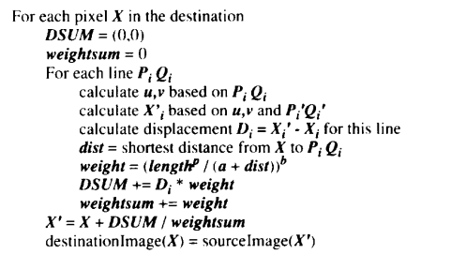
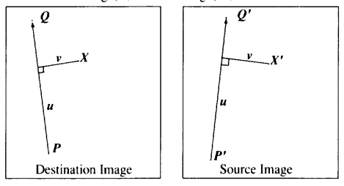
Morphing (Beier and Neely ‘92)

Slide 9
Multiscale Transfer of Local Contrast
Our goal is to match the visual style of the example without changing the identity of the input subject
That is, we want the output to represent the same person as the input with the same pose and expression, but with the color and texture distribution and overall lighting matching the example.
Working at multiple scales allows us to better capture the frequency profile of these elements
Technique builds upon the notion of power maps to estimate the local energy in each image frequency subband.
We first assume grayscale images and that the region of interest is the entire image. We later explain how to adapt our algorithm to deal with colors and to use a mask.

Slide 10
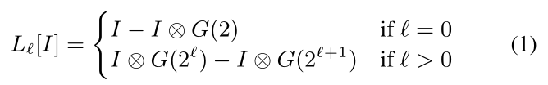
Multiscale Decomposition
The first step of our algorithm is to decompose the input and example images into multiscale Laplacian stacks
Procedure for the input image I; the same procedure applies for the example image E.
Construction uses a 2D normalized Gaussian kernel G(σ) of standard deviation σ.
Using ⊗ as the convolution operator, we define the level Lℓ at scale ℓ ≥ 0 of the input Laplacian stack as:

Slide 11
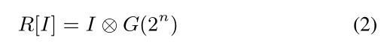
Multiscale Decomposition (Contd..)
For a stack with n ≥ 0 levels, we define the residual as:

Slide 12
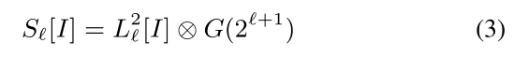
Local Energy
We estimate the local energy S in each subband by the local average of the square of subband coefficients.
Intuitively, this estimates how much the signal locally varies at a given scale.
Concretely, since we do not downsample the Laplacian layers, we adapt the size over which we average the coefficients to match the scale of the processed subband.
For the ℓth subband, this gives:

Slide 13
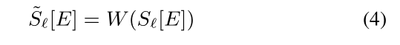
Local Energy (Contd..)
For the example image E, we account for the correspondence field that we have computed previously . Using W(·) for the warping operator defined by this field, we compute:
where we compute Sℓ[E] with Equation 3. Estimating the energy before warping the data avoids potential perturbations due to distortion and resampling.

Slide 14
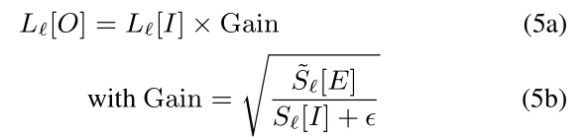
Robust Transfer
Using these two estimates (Eq. 3 and 4), we modify the input subbands so that they get the same energy distribution as the example subbands.
Letting O be the output image, we formulate a first version of our transfer operator as:
where 𝜺 is a small number to avoid division by zero (𝜺 = 0.012,) is between [0,1]) and the square root compensates for the square used to define the energy in Equation 3.

Slide 15
TASKS:
Implement Grabcut for Mask generation.
Identify facial features or keypoints
Implement morphing as described in the paper, Beier and Neely, ‘92
Multi-scale decomposition
Local Energy
Transfer using gain.

Slide 16
RESULTS

Slide 17
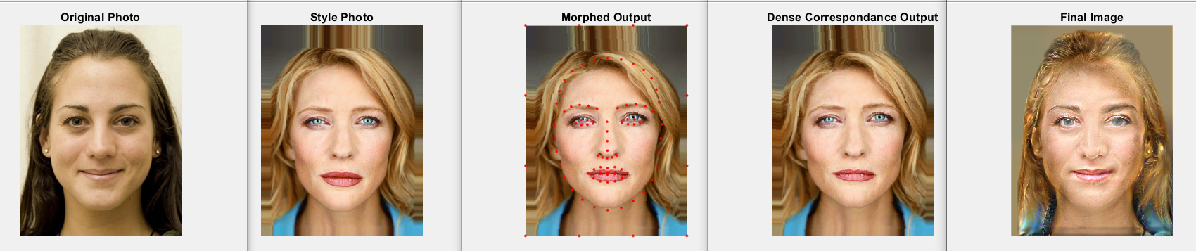
Result 1:

Slide 18
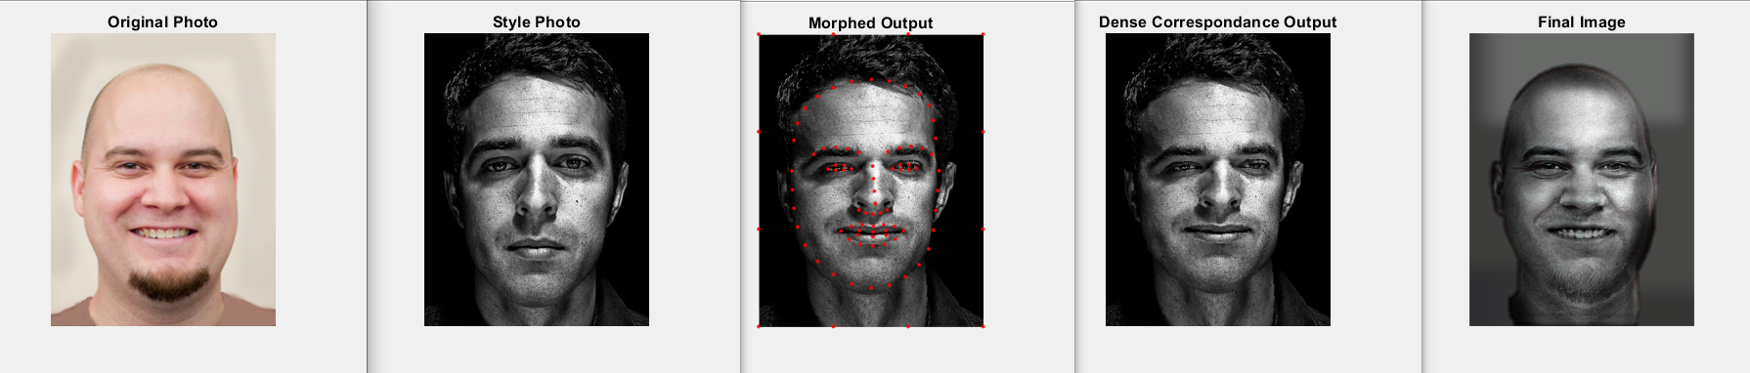
Result 2:

Slide 19
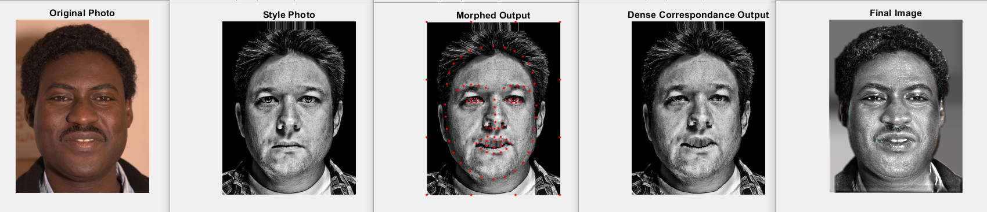
Result 3:

Slide 20
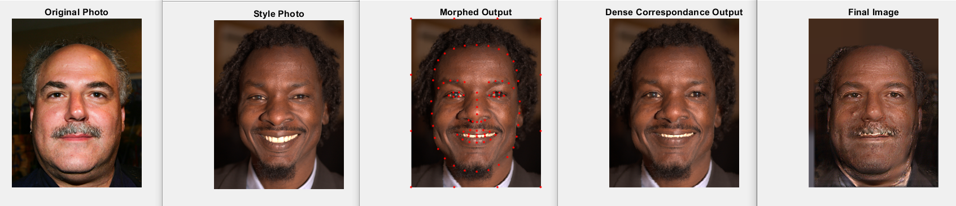
Result 4:

Slide 21
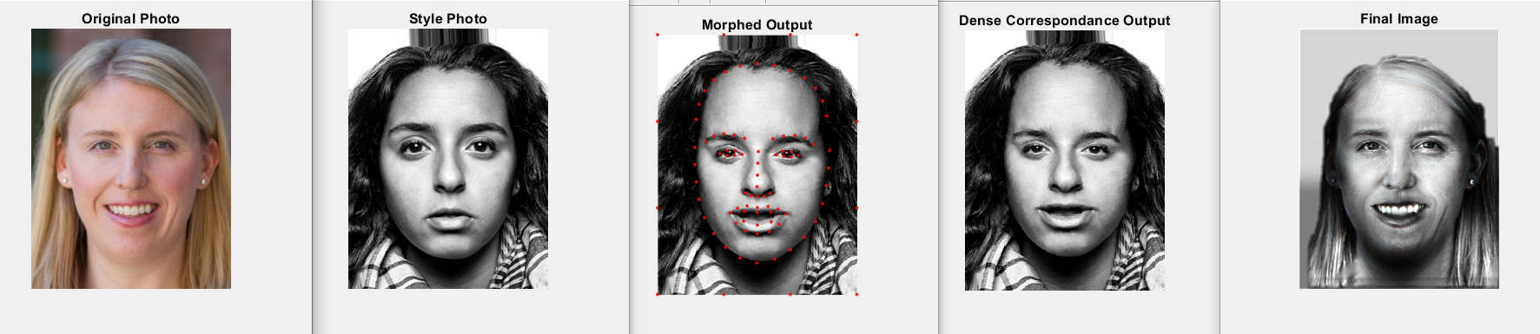
Result 5:

Slide 22
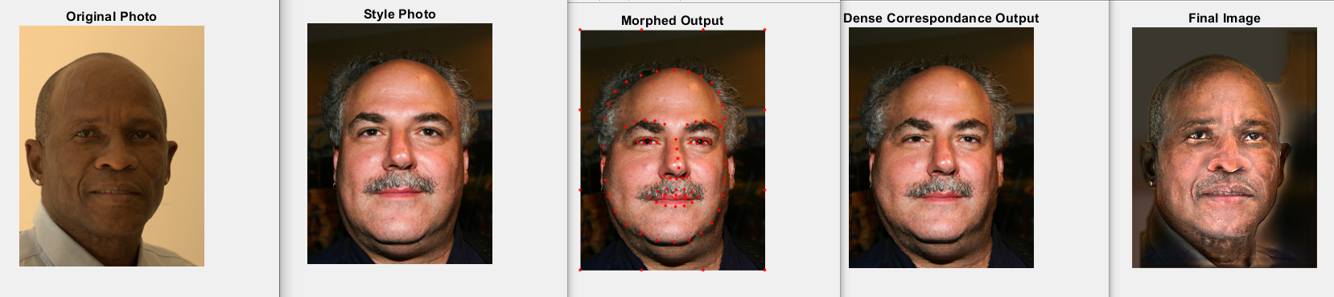
Result 6:

Slide 23
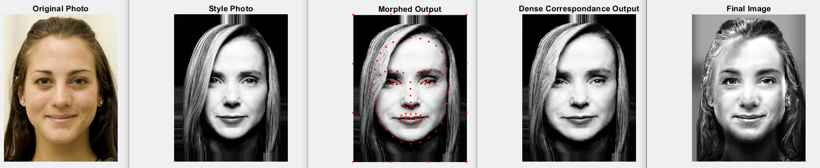
Result 7:

Slide 24
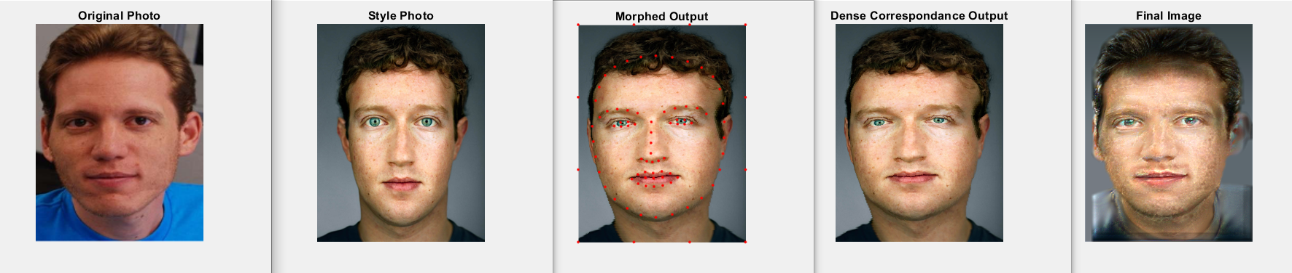
Result 8:

Slide 25
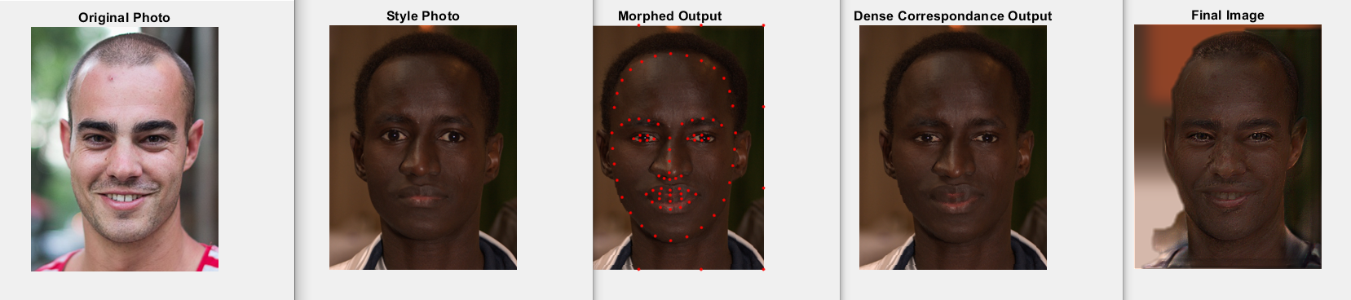
Result 9:

Slide 26
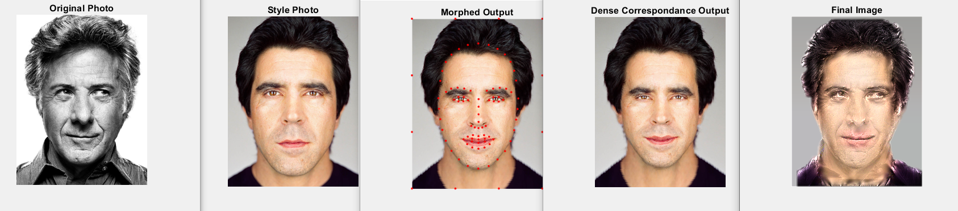
Result 10:

Slide 27
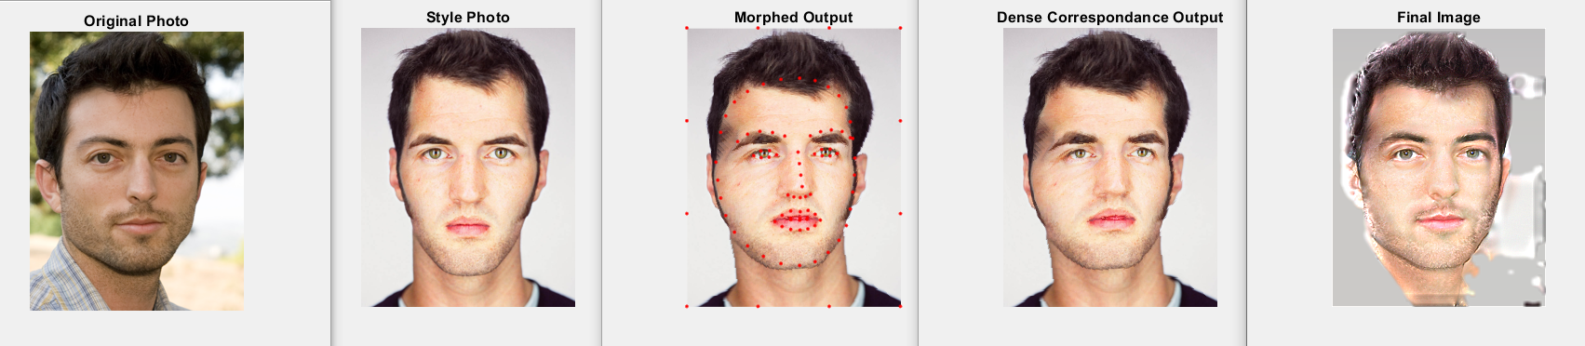
Result 11:
Reason: Improper Mask

Slide 28
RESULTS (Our Data):

Slide 29
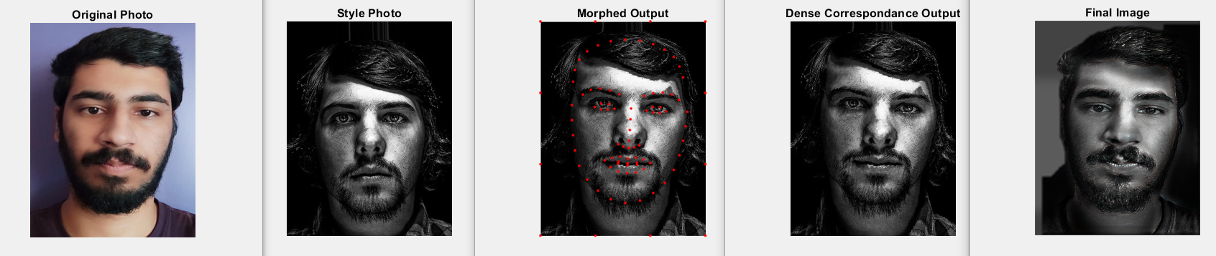
Result 1:

Slide 30
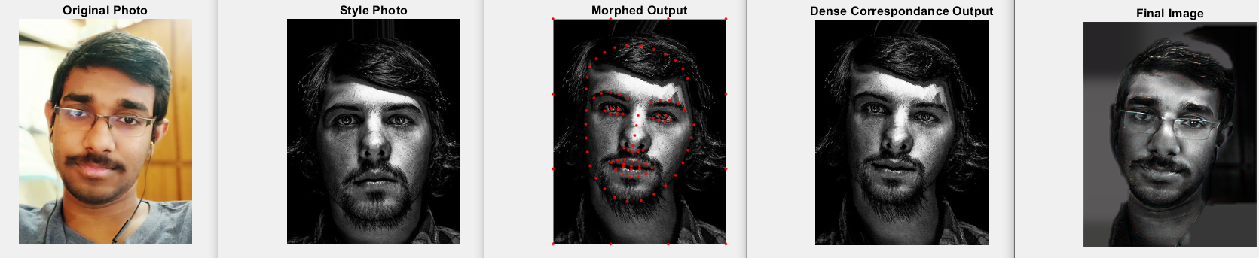
Result 2:

Slide 31
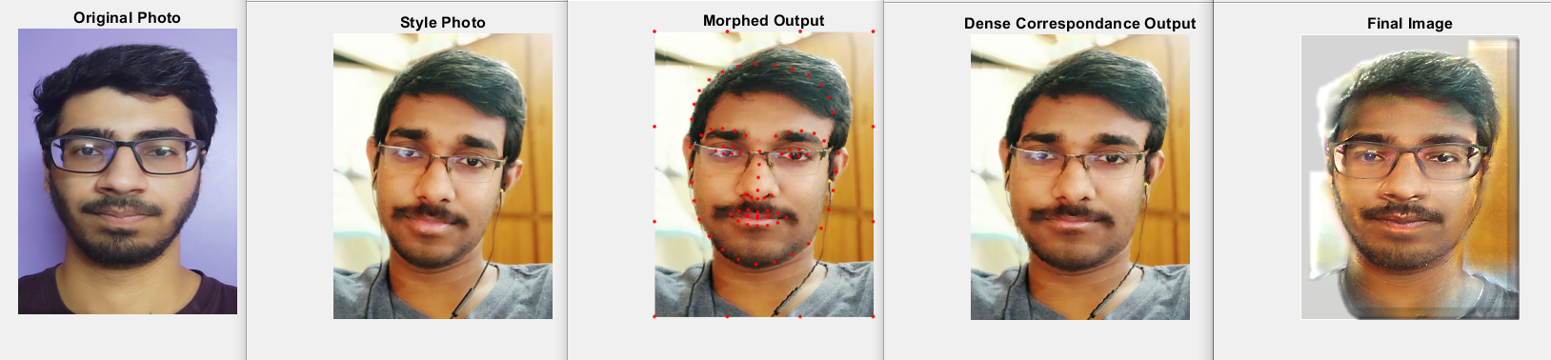
Result 3:

Slide 32
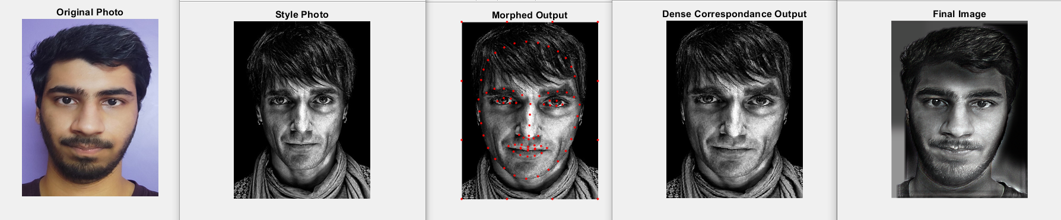
Result 4:

Slide 33
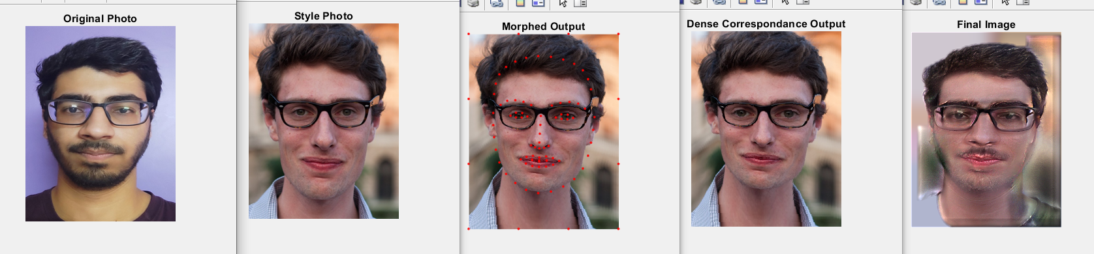
Result 5:
Reason: Mismatching Features.( Here beard)

Slide 34
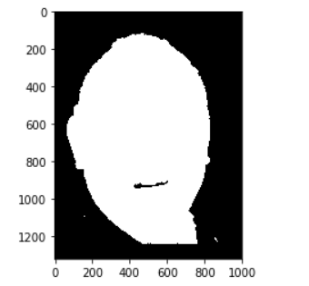
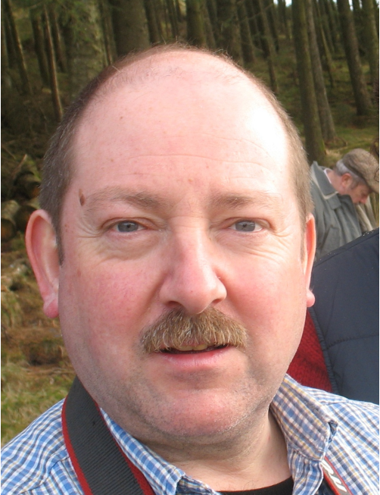
Grabcut mask results:

Slide 35
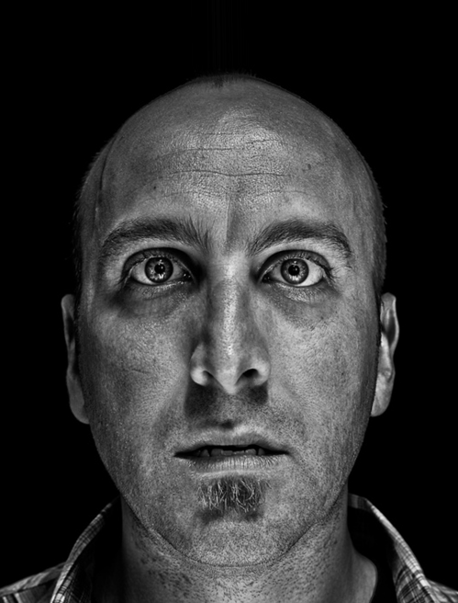
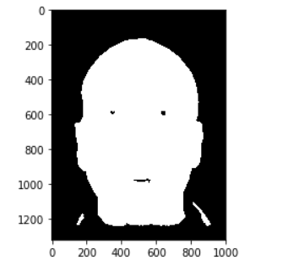
Grabcut mask results:

Slide 36
Work Division
Mask Generation | Sasi Kiran, Sai Krishna Charan
Dense correspondence | Sai Krishna Charan, Susheel
Laplacian Stacks | Harsha, Susheel
Local Energy | Sasi Kiran, Sai Krishna Charan
Gain Computation | Harsha, Susheel
Transfer of Gain | Sasi Kiran, Harsha
Reconstruction | Sasi Kiran, Sai Krishna Charan

